Slide 1


STUDENT DETAILS
Name : Ronit Saini
Student ID : STU645e78e63d0fd1683912934
Internship ID: INTERNSHIP_168198413964410a8b547b1
SkillsBuild Email ID : ronysaini1970@gmail.com
College Name : Manipal Institute Of Technology, Manipal
College State : Karnataka
Internship Domain : Artificial Intelligence (AI)
Internship Start and End Date : 12-06-2023 to 24-07-2023

Slide 2
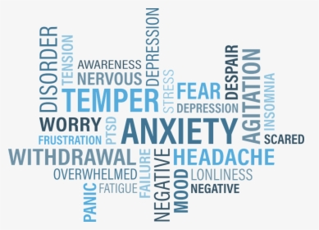


Slide 3
PROJECT TOPIC/Problem Statement
The problem statement or topic of this project is focused on analyzing and predicting mental fitness rates based on various factors such as schizophrenia, bipolar disorder, eating disorder, anxiety, drug usage, depression, and alcohol usage.
The project involves data analysis, data cleaning, exploratory analysis, and regression modeling techniques to predict the mental fitness rates.
The aim is to understand the relationships between different mental health factors and the overall mental fitness of individuals, and to develop a predictive model that can estimate mental fitness based on given input parameters.

Slide 4

AGENDA
1. Introduction
a. Overview of the project
b. Problem statement or topic
2. Project Overview
a. Purpose, scope, and objectives of the project
b. Target audience and their characteristics and needs
c. Benefits of the solution for end users
3. Solution Presentation
a. Description of the solution developed
b. How the solution addresses the needs of the end users
c. Unique aspects and innovative features of the solution
d. Utilization of technology principles in solution development
4. Modeling Techniques and AI/ML Principles
Overview of modeling techniques, methodologies, and frameworks used
b. Explanation of how AI/ML principles were applied in the solution
5. Outcomes and Results

Slide 5
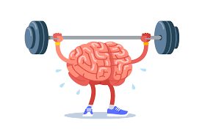
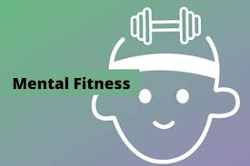

Slide 6
PROJECT OVERVIEW
The purpose of the project is to analyze and predict mental fitness rates based on various factors such as schizophrenia, bipolar disorder, eating disorder, anxiety, drug usage, depression, and alcohol usage. The project aims to explore the relationships between these factors and mental fitness, as well as develop a predictive model to estimate mental fitness based on the given input parameters.
The scope of the project involves performing data analysis, data cleaning, exploratory analysis, and regression modeling techniques. It includes importing the necessary libraries, reading data from CSV files, merging datasets, cleaning the data by handling missing values and removing unnecessary columns, and conducting exploratory analysis to gain insights into the data.
The objectives of the project are as follows:
Understand the relationships between different mental health factors and mental fitness rates.
Identify patterns and trends in mental fitness over time and across different countries.
Build regression models to predict mental fitness based on the given input parameters.
Compare and evaluate the performance of different regression models using metrics such as mean squared error (MSE), root mean squared error (RMSE), and R-squared.
Provide a user-friendly interface to allow users to input their information and obtain predicted mental fitness rates.
Overall, the project aims to contribute to a better understanding of mental health factors and their impact on mental fitness, as well as provide a tool for predicting individual mental fitness rates based on the available data.

Slide 7
WHO ARE THE END USERS OF THIS PROJECT
The target audience or end users of the project can be categorized into two main groups:
1. Mental Health Researchers and Professionals:
- Characteristics: Mental health researchers, psychologists, psychiatrists, and professionals in the field of mental health.
- Needs: These users are interested in studying mental health trends, exploring the relationships between different factors, and analyzing the impact of various variables on mental fitness.
- Benefits: The project provides these users with a comprehensive analysis of mental fitness rates, visualizations of the relationships between factors, and a predictive model to estimate mental fitness. This information can support their research, inform decision-making, and contribute to the development of strategies for improving mental health.

Slide 8
WHO ARE THE END USERS OF THIS PROJECT
people to proactively care about themselves and also encourages individuals to prioritize their mental well-being.
2. General Public and Individuals:
- Characteristics: General users, individuals seeking to understand their own mental fitness rates.
- Needs: These users are interested in gaining insights into mental health, understanding the impact of different factors on mental fitness, and obtaining an estimate of their own mental fitness based on their personal information.
Benefits: The project offers an interactive interface where users can input their relevant details, and the system provides an estimated mental fitness rate. This enables individuals to gain self-awareness about their mental fitness and potentially seek appropriate support or take actions to improve their mental well-being. It encourages

Slide 9

WHO ARE THE END USERS OF THIS PROJECT
Overall, the solution caters to both researchers and professionals in the mental health field, providing them with valuable insights and analysis, as well as the general public, offering a user-friendly interface to assess and monitor their mental fitness.
By providing accessible information and predictive capabilities, the project aims to empower users to make informed decisions regarding their mental health and contribute to overall well-being.

Slide 10



Slide 11
Solution Overview
1. Data Collection and Cleaning:
Gathered a rich dataset containing information on mental health prevalence and substance use disorders.
Conducted thorough data cleaning processes to ensure data integrity and reliability.
2. Exploratory Analysis:
Performed exploratory analysis to gain insights into the relationships between mental health factors and mental fitness rates.
Utilized visualizations and statistical techniques to identify patterns, correlations, and trends in the data.
3. Regression Modeling:
Developed regression models, including linear regression, support vector regression (SVR), random forest regression, and gradient boosting regression.
Trained the models on historical data to establish relationships and predict mental fitness rates.
4. Evaluation and Model Selection:
Evaluated model performance using metrics such as mean squared error (MSE), root mean squared error (RMSE), and R-squared.
Compared the performance of different models and selected the most accurate and reliable model for predicting mental fitness rates.

Slide 12
5. User Interface:
Designed an intuitive user interface where individuals can input their information and obtain an estimated mental fitness rate.
Ensured user-friendliness, accessibility, and privacy in the interface design.
6. Predictive Capabilities:
My solution leverages the trained regression models to provide accurate predictions of mental fitness rates based on user-provided data.
By considering a wide range of mental health factors, our solution offers a holistic perspective on mental well-being.
➔Value and Benefits:
- Empowers individuals to understand and monitor their mental fitness.
- Facilitates early intervention and proactive mental health management.
- Provides insights for mental health professionals and researchers to identify risk factors and patterns.
- Raises awareness about the importance of mental health and encourages open conversations.
My solution harnesses the power of AI and ML to analyze mental health factors and predict mental fitness rates. By offering valuable insights and accurate predictions, it contributes to improved mental well-being, proactive mental health management, and a deeper understanding of the intricate connections between mental health factors. This solution holds great potential for enhancing mental health support and fostering a healthier society.

Slide 13
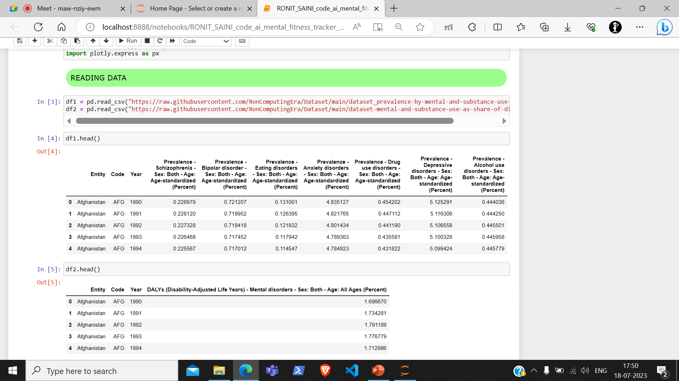
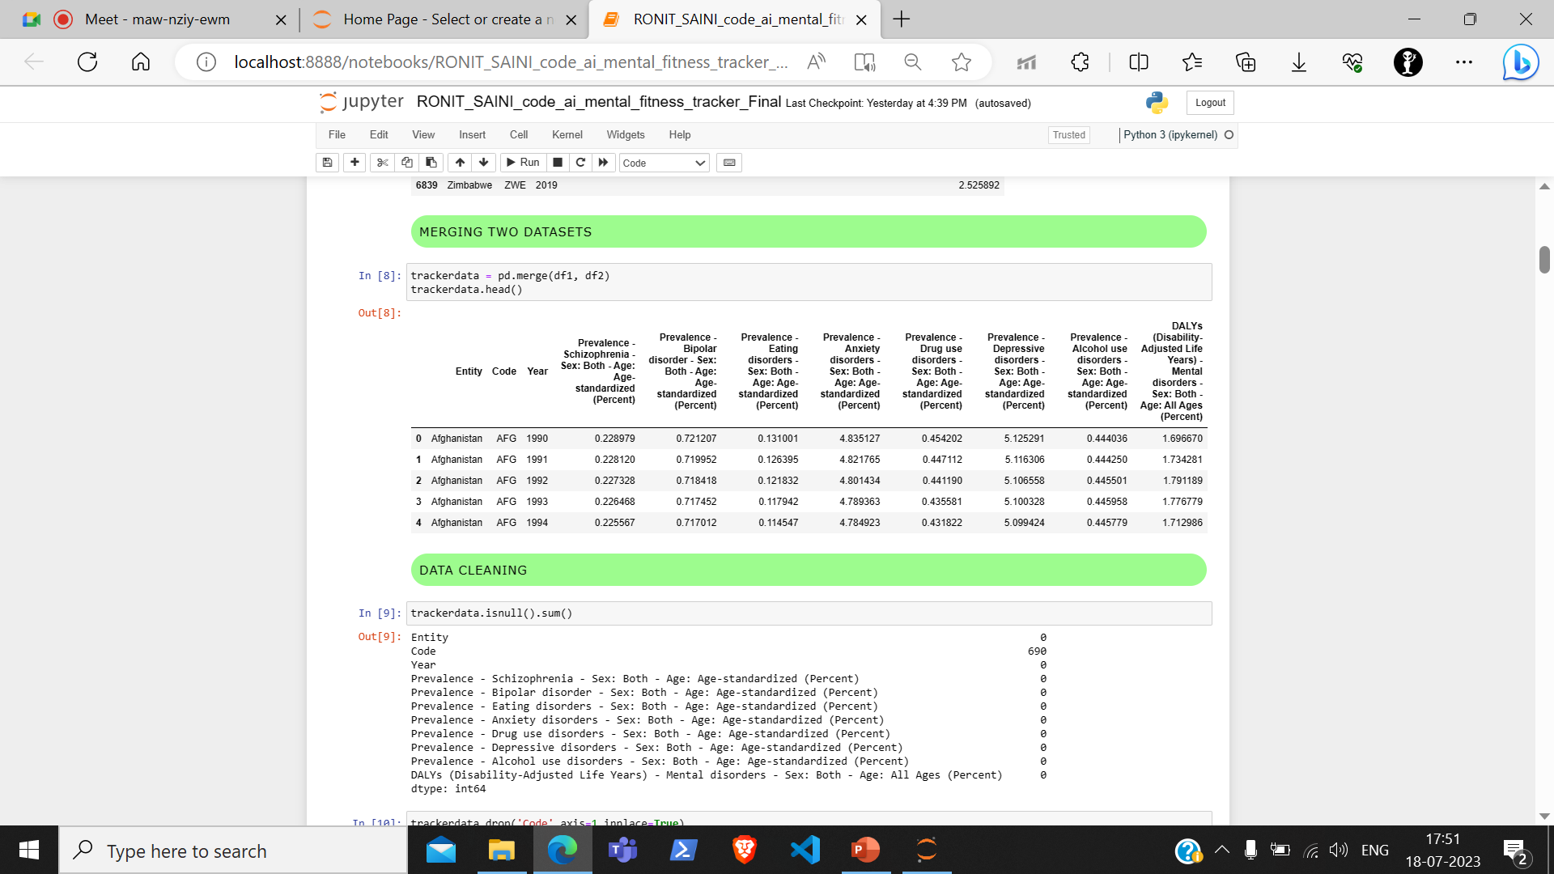

Slide 14
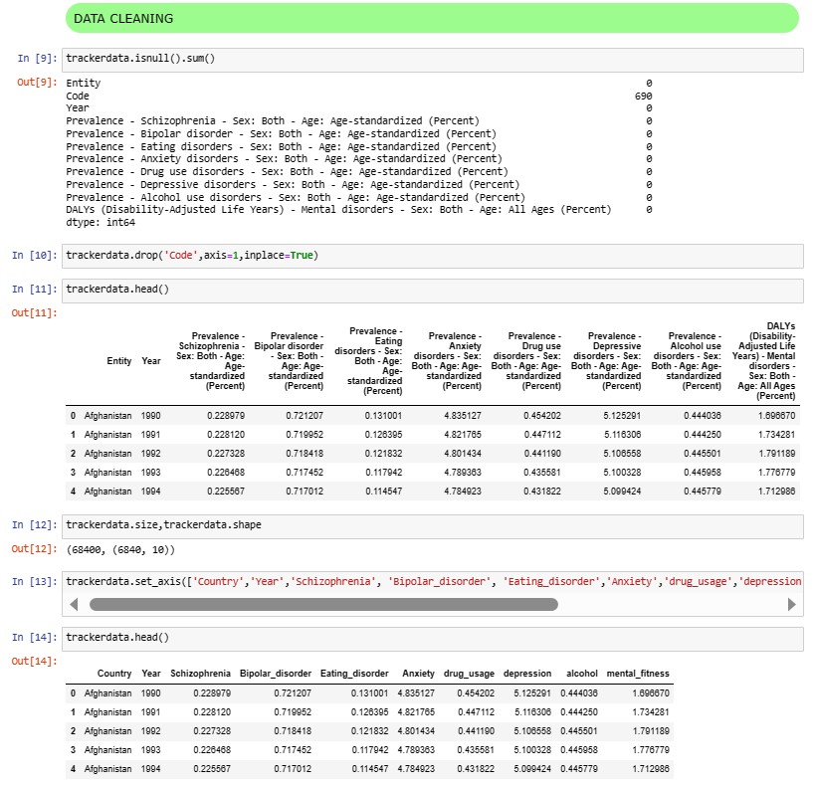

Slide 15
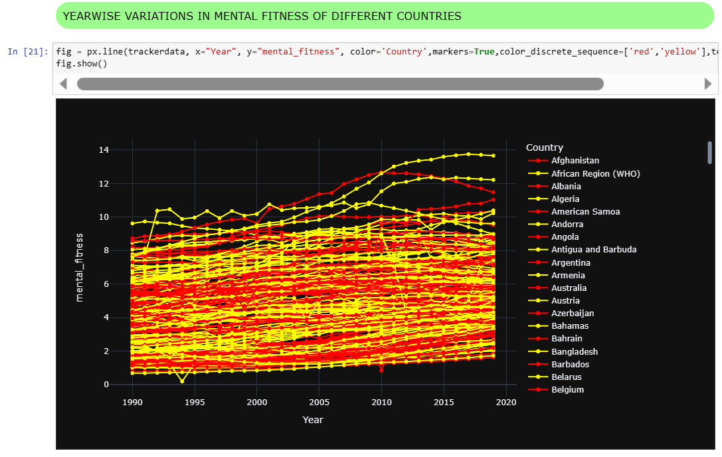

Slide 16
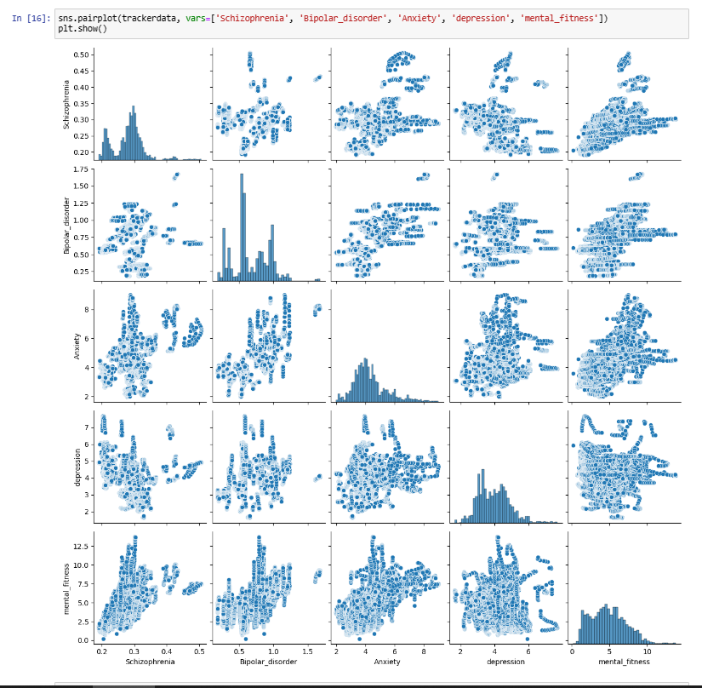

Slide 17
SOLUTION AND ITS VALUE PROPOSITION
My solution to the problem of analyzing and predicting mental fitness rates addresses the needs of both mental health researchers/professionals and the general public by providing valuable insights and a user-friendly interface. Here's how the solution meets the needs of the end users and the value it brings:
1. Mental Health Researchers and Professionals:
Needs addressed:
- Comprehensive Analysis: The solution offers a comprehensive analysis of mental fitness rates based on various factors such as schizophrenia, bipolar disorder, anxiety, depression, and more. Researchers and professionals can gain a deeper understanding of the relationships between these factors and mental fitness.
- Data Visualization: Through visualizations like correlation heatmaps, scatter plots, histograms, and pie charts, our solution facilitates the interpretation of complex data, enabling researchers to identify patterns, trends, and associations in mental health data.
- Predictive Modeling: By utilizing regression models, the solution helps researchers predict mental fitness rates based on input parameters. This predictive capability aids in forecasting and exploring future mental health scenarios.
Value provided:
- Enhanced Research Insights: Researchers and professionals can leverage my solution to enhance their studies and gain valuable insights into mental health factors, contributing to the development of evidence-based interventions, treatment plans, and policy recommendations.
- Time and Effort Savings: By automating data analysis, visualization, and predictive modeling tasks, my solution saves time and effort for researchers, allowing them to focus on interpreting results and making informed decisions.

Slide 18
SOLUTION AND ITS VALUE PROPOSITION
2. General Public and Individuals:
- Needs addressed:
Self-Awareness and Understanding: The solution enables individuals to gain self-awareness and a better understanding of their mental fitness rates by providing a user-friendly interface that estimates their mental fitness based on personal information. This promotes mental health literacy and encourages individuals to take proactive steps towards well-being.
Personalized Guidance: By obtaining an estimated mental fitness rate, individuals can assess their current mental well-being and identify areas of improvement. The solution can guide them towards seeking appropriate support, implementing self-care strategies, or seeking professional help as needed.
- Value provided:
Empowerment and Proactivity: The solution empowers individuals to actively engage in their mental health management. It promotes a sense of control, encourages self-reflection, and supports individuals in taking proactive steps towards improving their mental well-being.
Accessibility and Convenience: The user-friendly interface of the solution ensures accessibility to a wide range of users. It provides a convenient and quick way to assess mental fitness without the need for specialized knowledge or expertise.
Overall, my solution brings value by providing insights, analysis, and predictive capabilities to mental health researchers/professionals, facilitating their research and decision-making processes. Simultaneously, it offers the general public an accessible tool for self-assessment, awareness, and proactive management of mental well-being. By addressing the needs of both user groups, our solution contributes to the understanding and improvement of mental health at both individual and societal levels.

Slide 19
How did you customize the project and make it your own
User-Friendly Interface: I have developed a basic user-friendly interface that allows individuals to input their information and obtain an estimated mental fitness rate. The interface is designed to be intuitive, accessible, and easy to navigate, catering to users with varying levels of technical expertise.
Predictive Modeling: My solution utilizes some more regression modeling techniques, including linear regression, support vector regression, random forest regression, and gradient boosting regression, to predict mental fitness rates. This predictive capability sets my solution apart by enabling individuals and researchers to estimate mental fitness based on specific input parameters.
Visualization Capabilities: My solution incorporates even more data visualization techniques, such as heatmaps, scatter plots, histograms, and pie charts, to present the analysis and findings in an easily interpretable and visually appealing manner. Visualizations aid in understanding complex data patterns, identifying correlations, and communicating insights effectively.

Slide 20
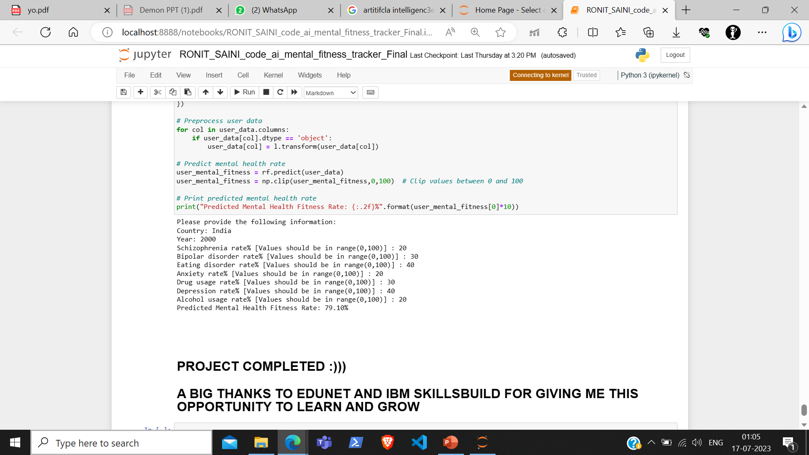
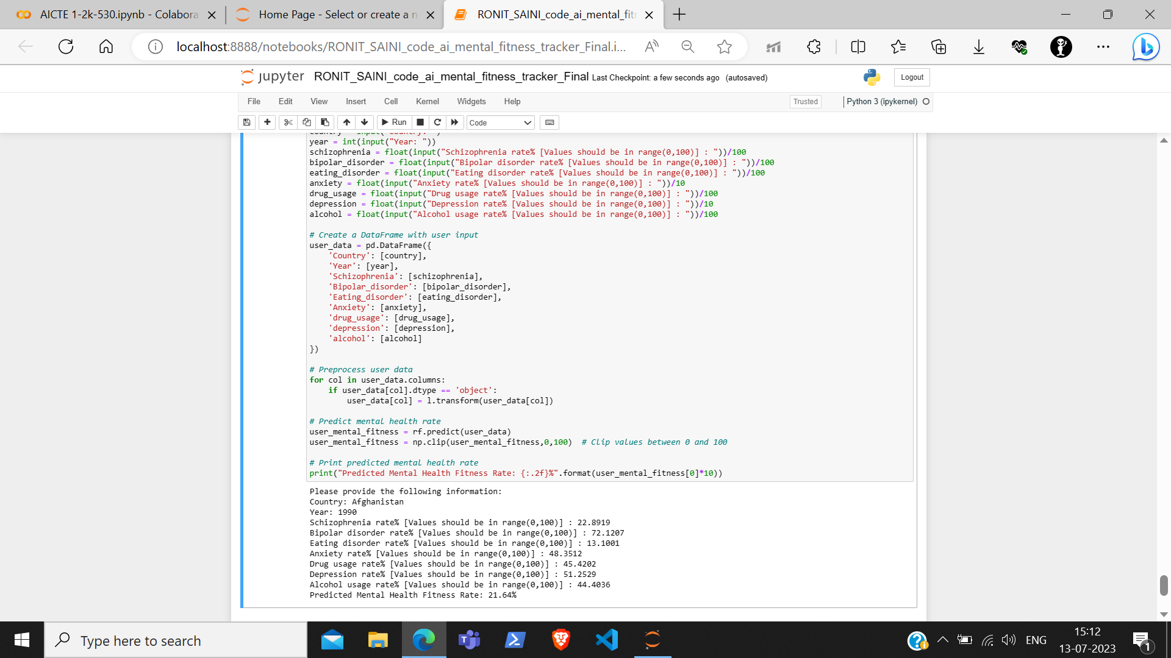
USER FRIENDLY INTERFACE

Slide 21
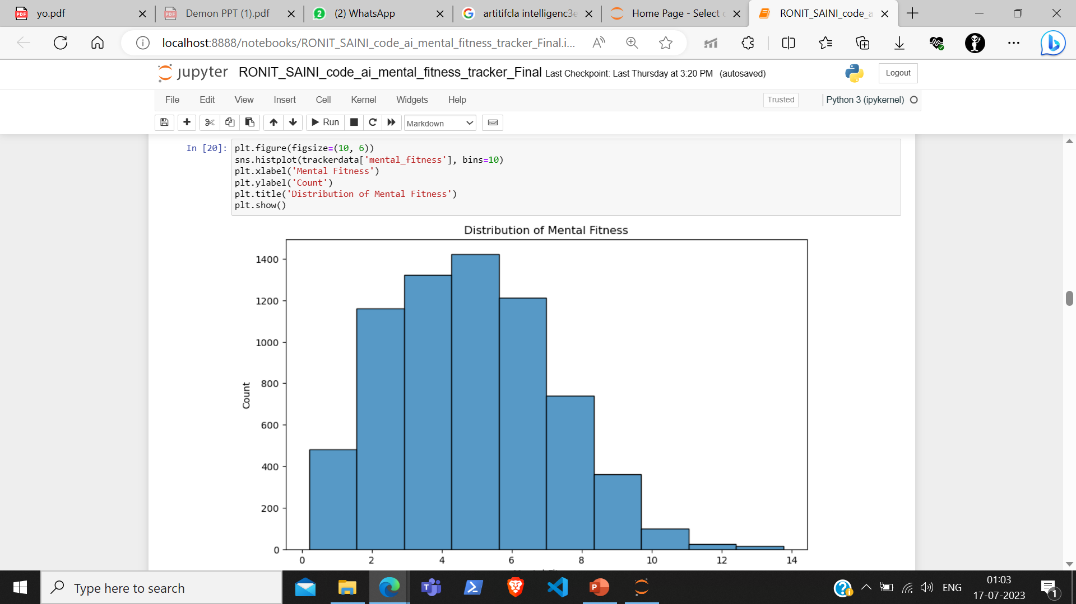
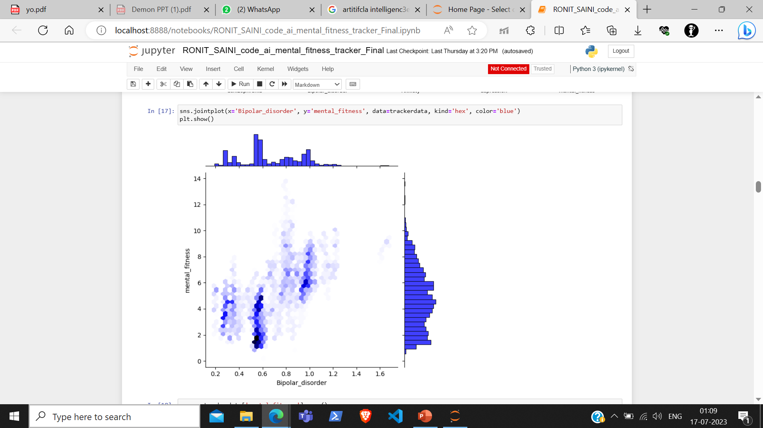
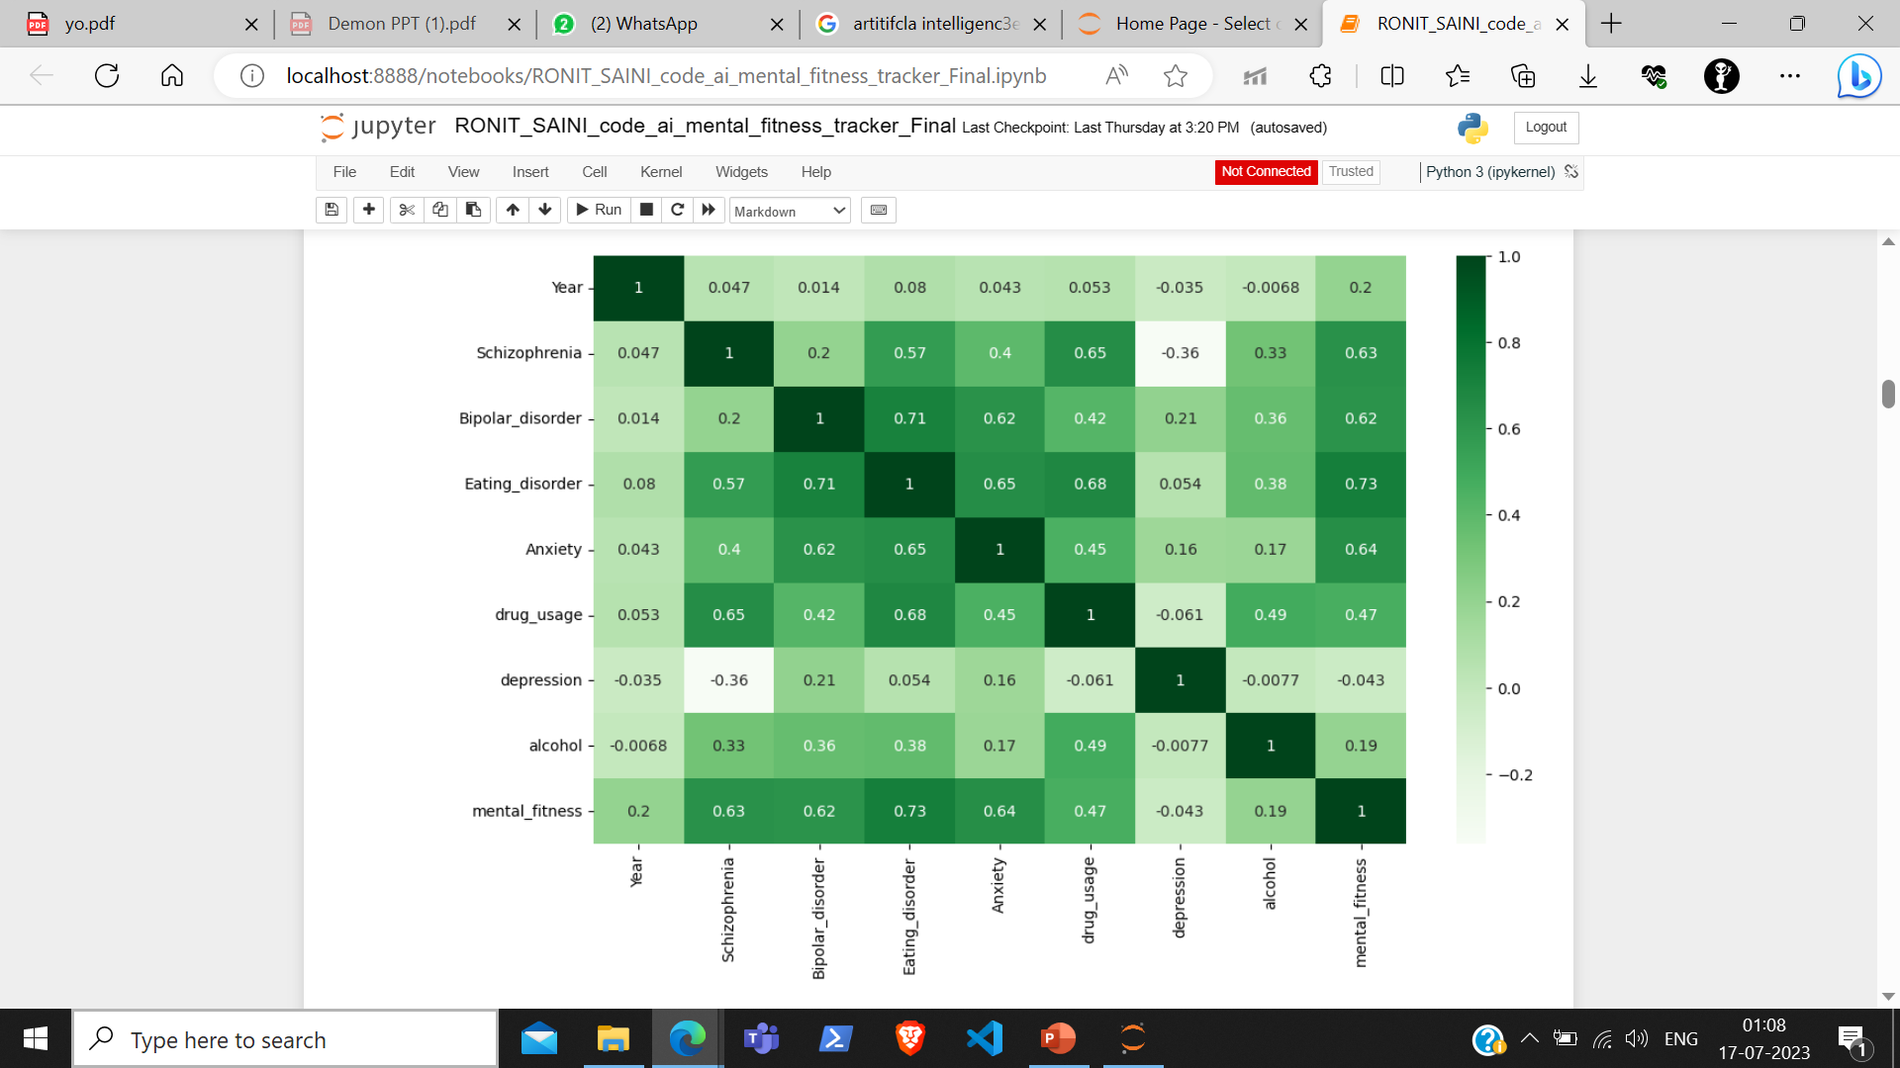
V
I
S
U
A
L
I
Z
A
T
I
O
N
Mean Mental Fitness

Slide 22
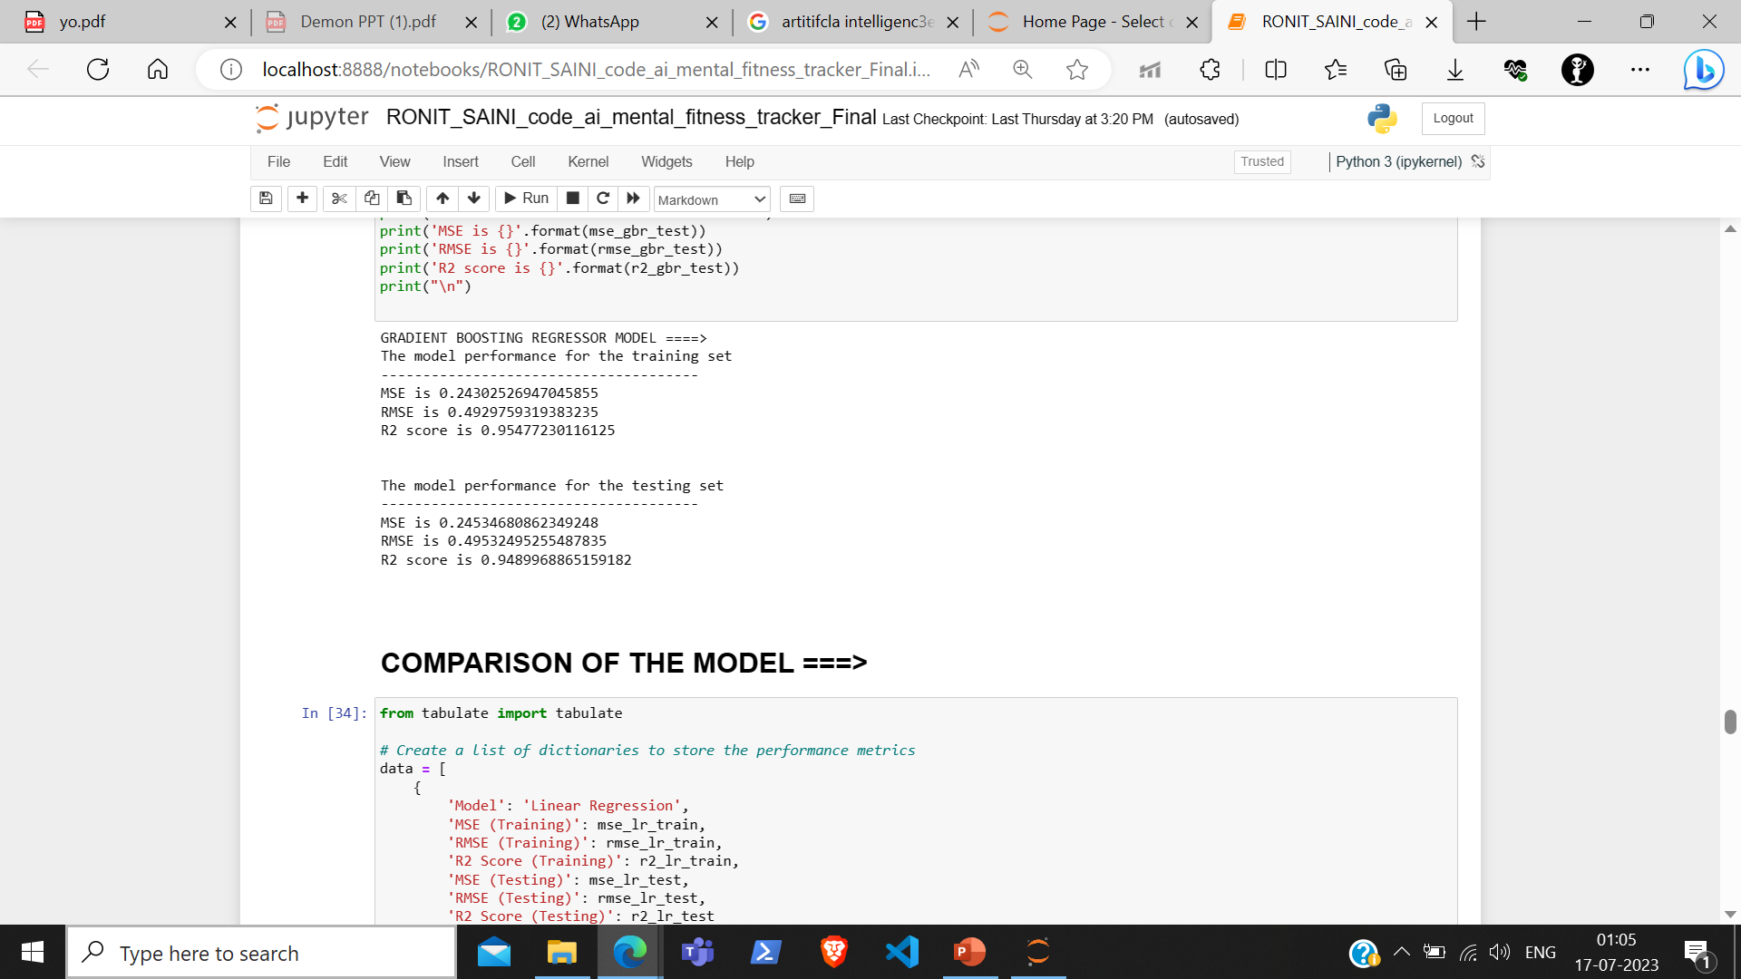
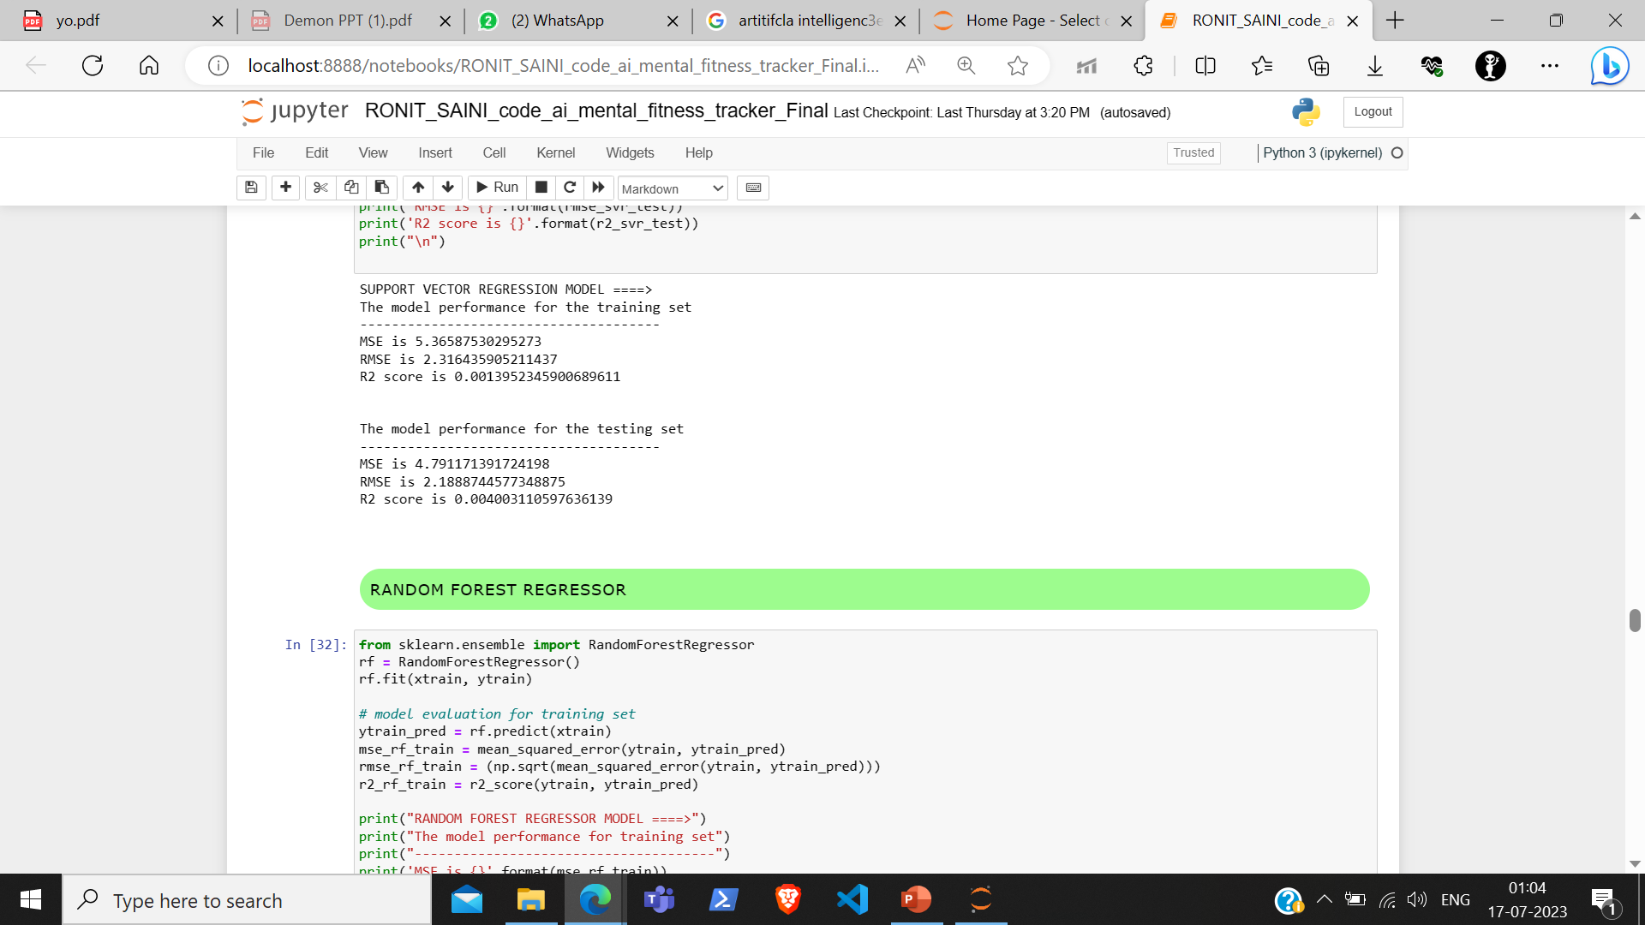
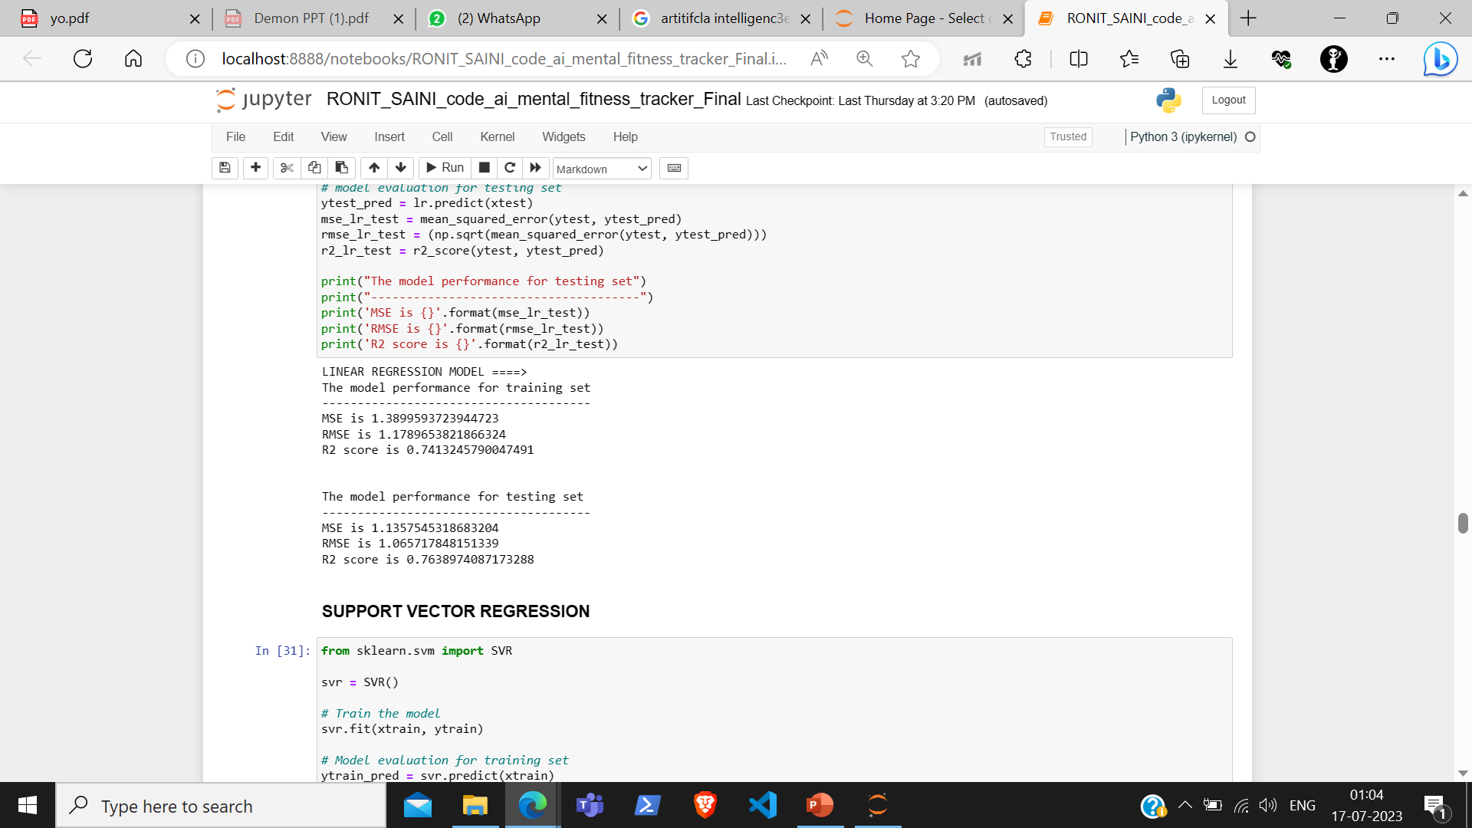
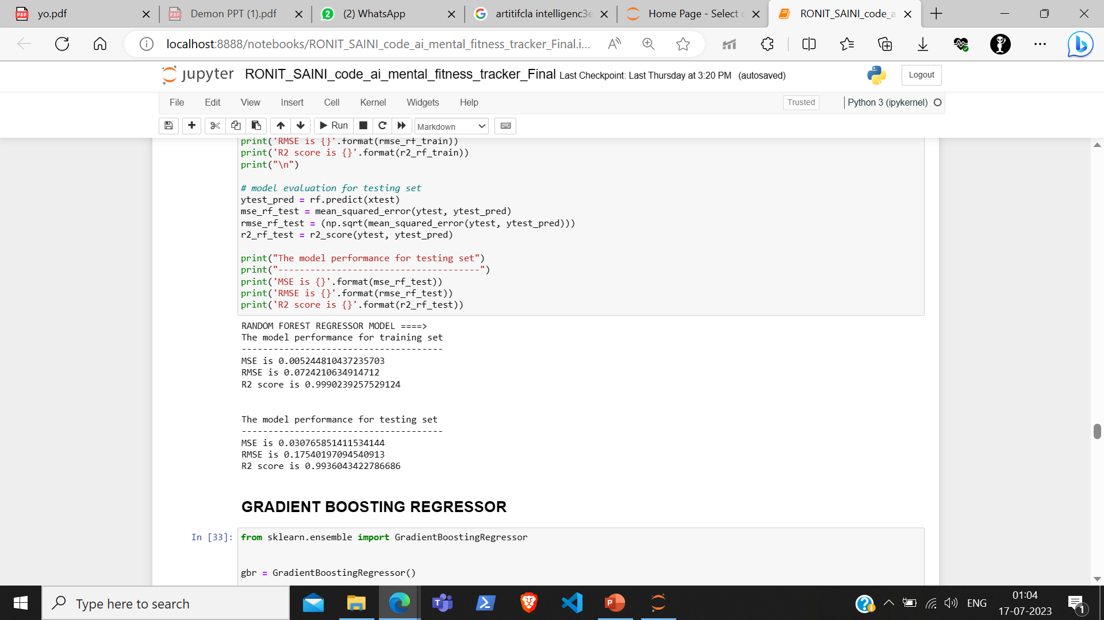
USE OF MULTIPLE REGRESSION MODELS

Slide 23

MODELLING
The project applies various modeling techniques, methodologies, and frameworks to develop the solution. It leverages AI and ML principles to analyze and predict mental fitness rates. Here's how technology principles are utilized in the development of the solution:
1. Regression Modeling: The project utilizes regression modeling techniques, including linear regression, support vector regression (SVR), random forest regression, and gradient boosting regression. These regression models are trained on the available data to establish relationships between the input variables (mental health factors) and the target variable (mental fitness rate). The models learn from historical patterns and make predictions based on the input parameters.
2. Data Preprocessing: Before applying the models, data preprocessing techniques are employed to clean and transform the data. This involves handling missing values, dropping unnecessary columns, encoding categorical variables, and standardizing or normalizing numerical variables. These preprocessing steps ensure that the data is in a suitable format for training the models.
3. Evaluation Metrics: To assess the performance of the models, evaluation metrics such as mean squared error (MSE), root mean squared error (RMSE), and R-squared are utilized. These metrics measure the accuracy and predictive power of the models and provide insights into how well the models fit the data.

Slide 24
MODELLING
4. Ensemble Learning:
Ensemble learning techniques, such as random forest and gradient boosting, are employed to combine multiple models and enhance the prediction accuracy. Ensemble methods harness the collective intelligence of multiple models to make more accurate predictions.
5. Model Comparison and Selection:
Different regression models are trained and evaluated on the data to compare their performance. This allows for the selection of the most suitable model based on evaluation metrics and the specific requirements of the project.
6. Machine Learning Libraries and Frameworks:
The project relies on popular machine learning libraries and frameworks such as scikit-learn, pandas, NumPy, and plotly. These libraries provide a wide range of functions, algorithms, and tools for data preprocessing, modeling, evaluation, visualization, and other ML-related tasks.
By leveraging these modeling techniques, methodologies, and frameworks, the project applies technology principles to develop a solution that can analyze, predict, and estimate mental fitness rates based on a variety of mental health factors. These principles enable the solution to learn from data, make predictions, and provide valuable insights into mental well-being.

Slide 25
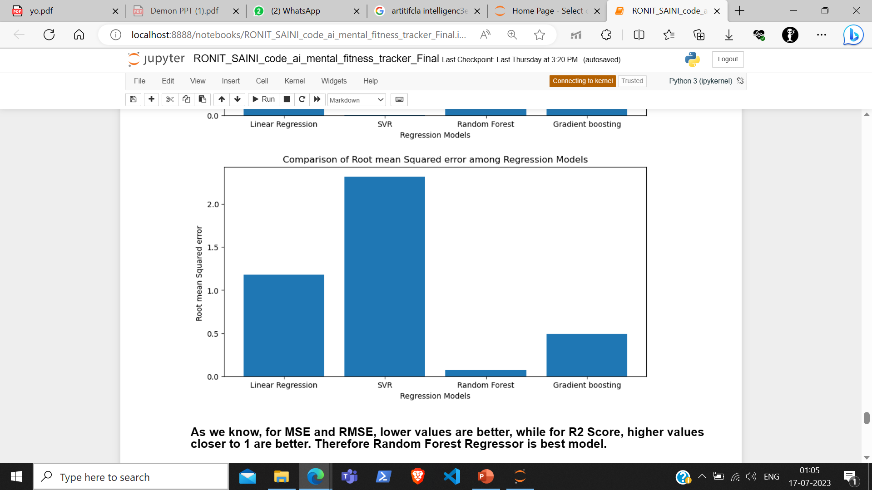
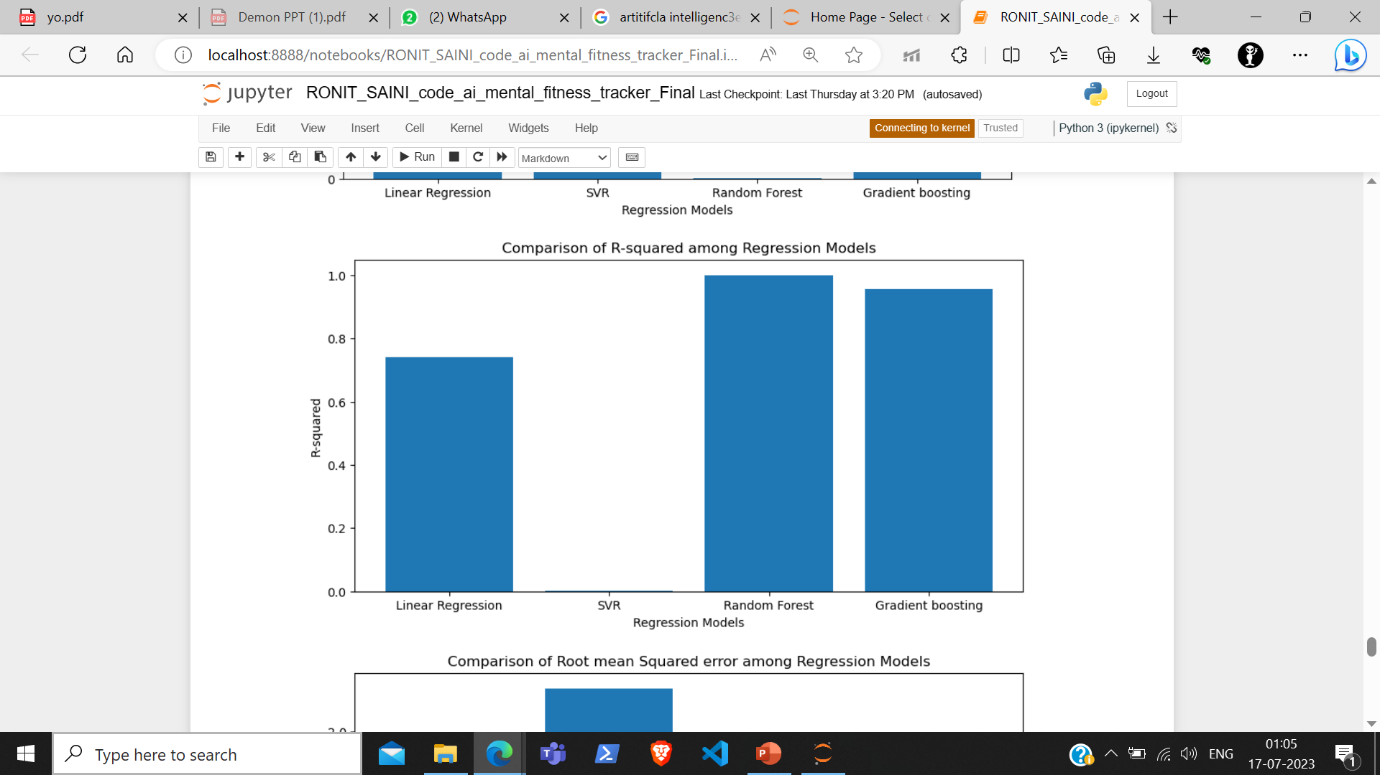
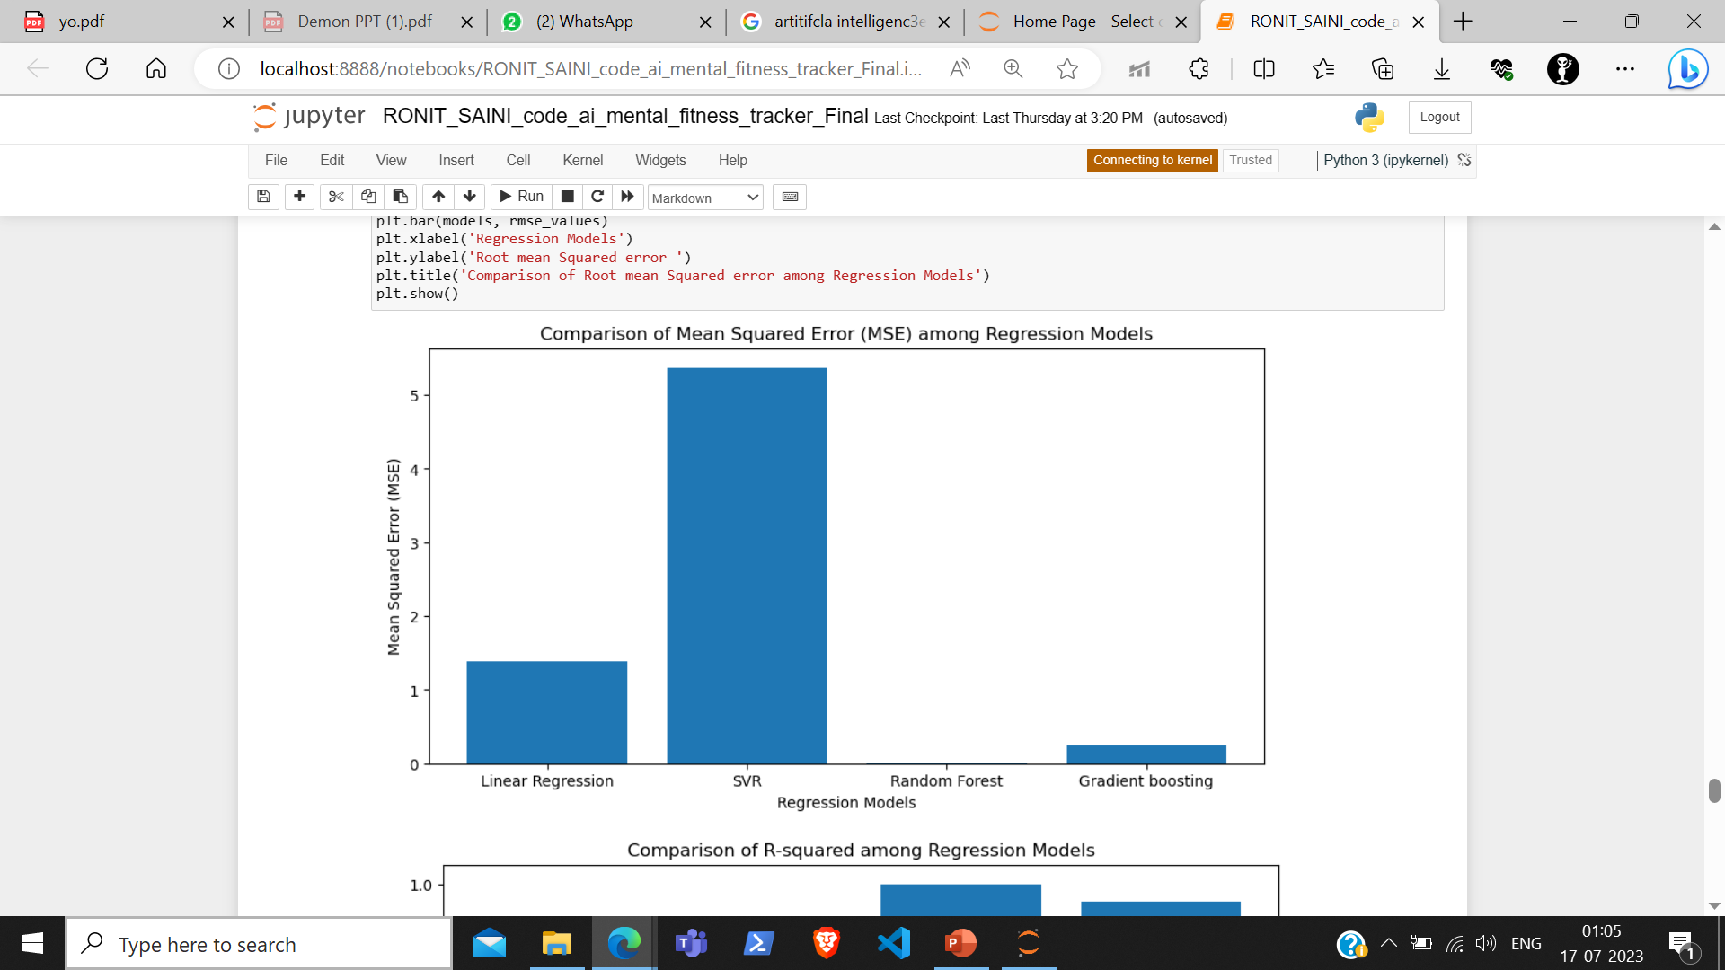

Slide 26
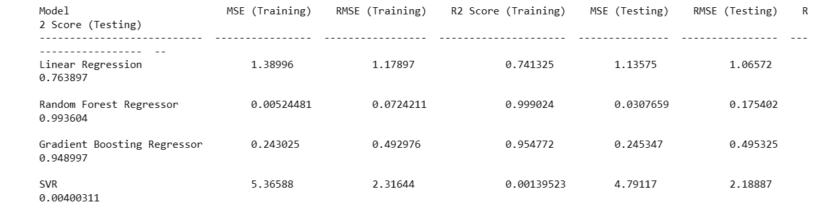
RESULTS
My project aimed to analyze mental health factors and predict mental fitness rates based on a comprehensive dataset. By leveraging AI and ML techniques, we developed regression models and explored the relationships between various mental health factors and overall mental fitness.
I found out that out of the models used, Random Forest Regressor is the best model for prediction mental fitness rate
My project successfully developed a solution that predicts mental fitness rates based on a wide range of mental health factors. The regression models, evaluation metrics, and data visualizations enabled us to gain valuable insights into mental well-being. This project contributes to a better understanding of mental health and empowers individuals to actively manage their mental fitness.

Slide 27

LINKS
Dataset Link : https://github.com/RonComputingEra/Dataset
Google-Drive Project Link : https://drive.google.com/drive/folders/1QObW9i7hmg__gdK2sqSL5Z_SYdzLm6mo?usp=sharing
Google-Drive Code Link: https://drive.google.com/file/d/1Sdcwp-mr_PDFNzlK2vGMsaCSOlksP7re/view?usp=sharing
Google-Drive Certificates Link : https://drive.google.com/drive/folders/1hQCQtPSfAzak09MJO2uksQAitxdT9z0s?usp=sharing

Slide 28


